Slide 1
Wilson-cowan model and its application to epilepsy
Michael Terranova
Ben Connor

Slide 2
What is Epilepsy?
Epilepsy is a class of neurological syndromes categories by seizures
Seizures are brief episodes of hyper-synchronous firing in localized areas of the brain
Symptoms range from loss of consciousness, to involuntary movement
The most common identification of a seizure for most people is “tonic clonic”

Slide 3
Tonic clonic seizures
The tonic phase:
Stiff muscles, air forced through vocal cords
Consciousness lost
Tongue biting, perhaps resulting in injury
Clonic phase:
Arms and legs jerk rhythmically, eventually subsiding with consciousness returns

Slide 4
How do we measure seizure activity?
EEG’s are the most common way to diagnose epilepsy, and actually have applications to the mathematical models in terms of bursting and oscillations
An Electroencephalogram measures voltage fluctuations by applying electrodes on the scalp, which typically takes place over multiple time series across several regions of the brain
On the next slide, I’ll show a normal EEG pattern, as well as an EEG during a tonic-clonic seizure
There are many classifications of rhythm, such as alpha and beta, which are largely not relevant to the goal of this

Slide 5
The sample of human EEG with in resting state
Note the lack of synchronous activity, and relatively normal looking wave patterns

Slide 6
Note the hypersynchronous activity and the “bursts” between neuronal populations
Tonic-Clonic seizure

Slide 7
Solutions
The following equations were used in the XPP file and the Neuron file: f(u)=1/(1+exp(-u)) u'=-u+f(aee*u-aie*v-ze+i_e(t)) v'=(-v+f(aei*u-aii*v-zi+i_i(t)))/tau With u’ being excitatory and v’ being inhibitory, f(u) is a rudimentary sigmoidal function to account for firing rate
Here were the initial parameter values: par aee=10, aie=8, aei=12,aii=3,ze=.2,zi=4 par tau=1 par ie0=0, ie1=0,w=.25 par ii0=0,ii1=0
i_e(t) and i_i(t)are external inputs to the excitatory and inhibitory population
aie, aee, aei, and aii correspond to connectivity strength between the subpopulations.
ie0, ie1, ii0, and ii1 are parameters controlling the input to each subpopulation (ie0, iel for the excitatory input; ii0, ii1 for inhibitory input)
ze, and zi are used to control the delay. The timescale tau divides only the derivative of the inhibitory variable v’ because it can give us more control over the response of the inhibitory population.

Slide 8
Equations
Sigmoidal
Wilson-Cowan system

Slide 9
Results in xpp and neuron
-Phase plane solution in neuron with default params where
conditions u(0) = 0.1 and v(0) = 0.05 -Stable spiral fixed point at (u*, v*) = (0.5311, 0.6233)

Slide 10
Results in xpp and neuron
(zoomed view)
-XPP: bifurcation diagram of the excitatory subpopulation (u) with respect to the excitatory-to-excitatory connectivity parameter (aee). Red arm above the orbit shows hysteresis.
-The green dots represent a periodic solution of a supercritical Hopf bifurcation
-param aee* = 10.7871 to aee* = 11.3544:

Slide 11
Results in xpp and neuron
-(u, v)-phase plane -aee is now 11 -unstable spiral at 0.62986, 0.7746 -light blue lines:rajectories -black lines:stable limit cycle
-blue lines:unstable trajectories -the green line is the v-nullcline; and the red line is the u-nullcline:

Slide 12
Results in xpp and neuron
-aee=11.34 -Periodic Solution with default parameters at FP (0.70402, 0.86463)

Slide 13
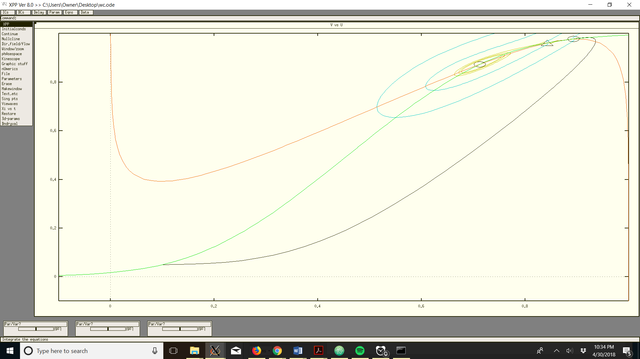
Results in XPP And neuron
When aee is changed to 11.36, there is hysteresis and bi-stability

Slide 14
Neuron simulations
U’ and V’ against time with aie, inhibitory-to-excitatory connnectivity, at 20, and aee, or excitatory input to excitatory at 10. This small amount of activity and lack of synchrony is analogous to a resting state EEG measurement.

Slide 15
Neuron Simulations
The U’ vs V’ plot as well as the coupled cells across time with no drive. This means that there was not any external input to the system.

Slide 16
Neuron simulations CoNt’d
Plot of v’ and u’ vs time with a drive of ie, or inhibitory input to excitatory of 0.5 and ii or inhibitory to inhibitory of 0.5

Slide 17
Neuron simulations Cont’d
U’ and V’ vs time and a plot of solutions with Aie, or inhibitory-to-excitatory at 20, and ie1, or inhibitory to excitatory input at 10.5, and ii1, or inhibitory to inhibitory input at 0.5

Slide 18
Neuron Cont’d
aie=20, tau=80,ie_1=10.5,ii_1=0.5. This demonstrates, as shown in the phaseplane, the effect of over excitation on seizure like activity

Slide 19
Extensions
A spatially dependent version of the Wilson-Cowan model that measures the cortical surface of and determines the average firing rate. It has been used successfully to calculate the rate of expansion of hyper-synchronized regions of the brain, which helps to determine how long a seizure may last, or when it may start

Slide 20
Conclusions
Base level, we can infer that it is reasonable to use a more macro scale model to examine oscillations in epileptiform activity.
Microscale models such as Morris-Lecar and HH could complicate analysis, as we are talking about coupling thousands of neurons
The WC model works well as starting point for other models
From neuron, it’s clear that a reasonable ratio of excitatory to inhibitory input produces plots similar to a resting state EEG. As shown, with no driving force, or stimulation, it tapers off over time. Increasing drive from excitatory input demonstrates hypersynchronous and oscillatory solutions, which are consistent with theories of hyperexciation and synchrony in biological models of epilepsy
Through the bifurcation diagrams and phase planes in XPP and the time scales in Neuron, we were able to simulate neuronal firing behavior. Although our use of the Wilson-Cowan model was simple, there have been intricate and important extensions of the model made for describing and even treating epileptic seizures in the brain.

Slide 21
References
Kilpatrick, Zachary P. “Wilson-Cowan Model.” Encyclopedia of Computational Neuroscience, 2013, pp. 1–5., doi:10.1007/978-1-4614-7320-6_80-1.
“Epilepsy.” World Health Organization (WHO), 8 February 2018, http://www.who.int/en/news-room/fact-sheets/detail/epilepsy. Accessed 26 April 2018.
Stefanescu RA, Shivakeshavan RG, Talathi SS. “Computational models of epilepsy.” Seizure, vol. 21, no. 10, December 2012, pp. 748-59. ScienceDirect, doi: 10.1016/j.seizure.2012.08.012
Both the .ode and .mod (for Neuron) files for the Wilson-Cowan Model were created by Bard Ermentrout came from the following link on ModelDB: “Excitatory and inhibitory interactions in populations of model neurons (Wilson and Cowan 1972).”
URL: https://senselab.med.yale.edu/modeldb/ShowModel.cshtml?model=76879
EEG chart of Tonic-clonic seizure came from: Chapter 13: Primary Generalized Tonic-Clonic Seizures. (n.d.). Retrieved from: https://neurology.mhmedical.com/content.aspx?sectionid=59103058&bookid=1045
V. Shusterman and W. C. Troy. “From baseline to epileptiform activity: A path to synchronized rhythmicity in large-scale neural networks.” Phys Rev E Stat Nonlin Soft Matter Phys. 2008;77(6 Pt 1):061911 PMID 18643304.

